Slide 1
CS3CO43 Computer Network
Unit -4 Transport Layer

Slide 2
Content
Transport Layer
Design Issues, Transport Service Primitives,
Socket Programming,
TCP: Connection Management,
Reliability of Data Transfers,
TCP Flow Control,
TCP Congestion Control,
TCP Header Format, TCP Timer Management.
UDP: Header Format,
RPC, RTP,
Session layer: Authentication, Authorization, Session layer protocol (PAP, SCP, H.245).
.

Slide 3
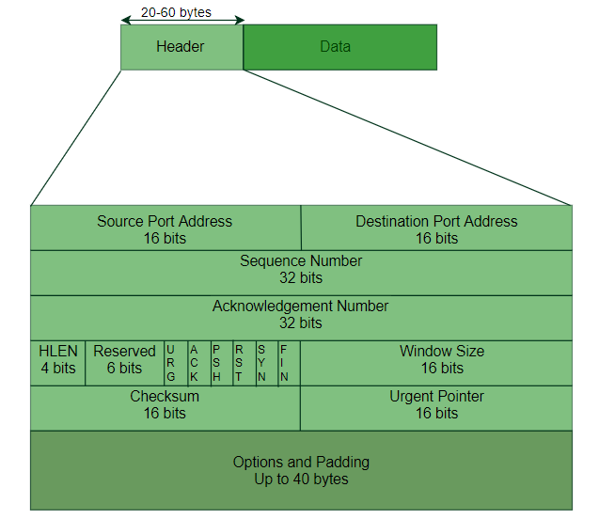
TCP Segment structure

Slide 4
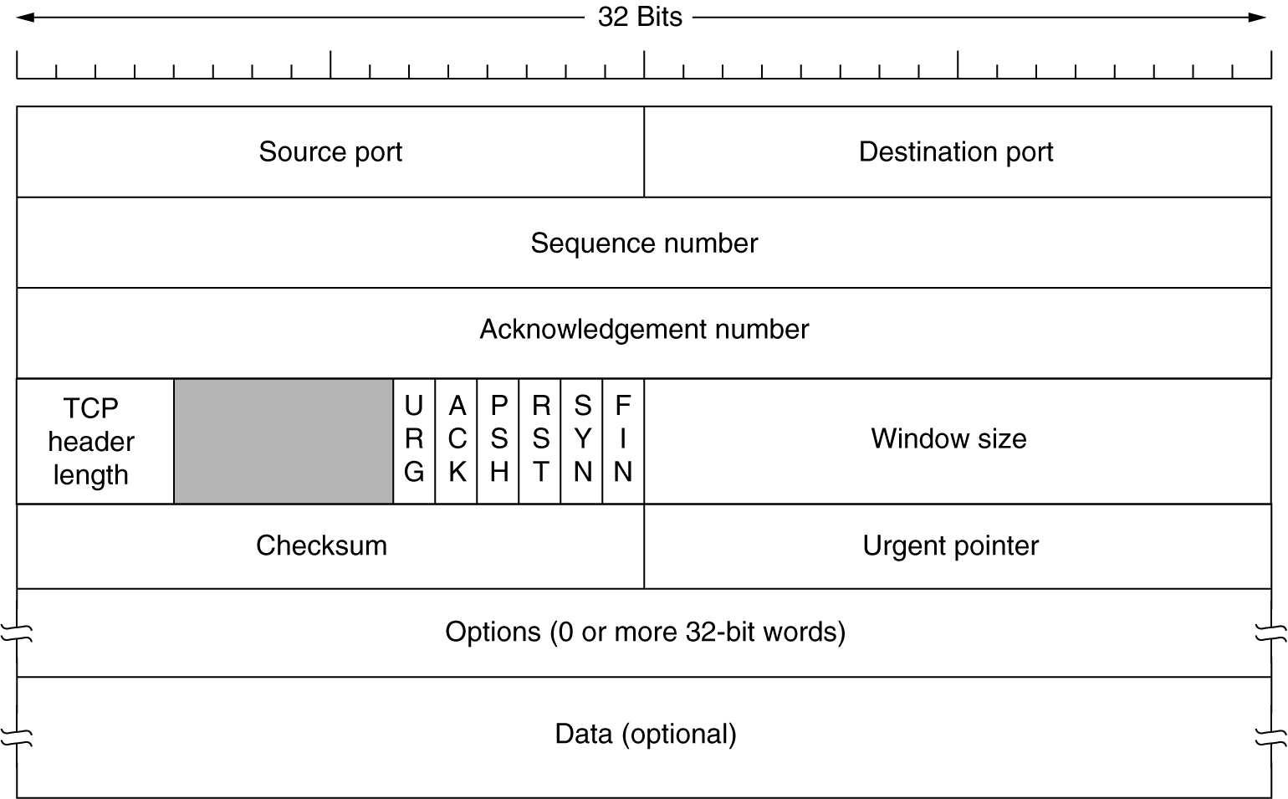
The TCP Segment Header

Slide 5
Header Fields
The header of a TCP segment can range from 20-60 bytes. 40 bytes are for options. If there are no options, header is of 20 bytes else it can be of upmost 60 bytes.
Source Port Address
16 bit field that holds the port address of the application that is sending the data segment.
Destination Port Address
16 bit field that holds the port address of the application in the host that is receiving the data segment.

Slide 6
Header Fields
Sequence Number
32 bit field that holds the sequence number, i.e, the byte number of the first byte that is sent in that particular segment. It is used to reassemble the message at the receiving end if the segments are received out of order.
Acknowledgement Number
32 bit field that holds the acknowledgement number, i.e, the byte number that the receiver expects to receive next. It is an acknowledgment for the previous bytes being received successfully.

Slide 7
Header Fields
Header Length (HLEN) – it uses scale of 4
This is a 4 bit field that indicates the length of the TCP header by number of 4-byte words in the header, i.e, if the header is of 20 bytes(min length of TCP header), then this field will hold 5 (because 5 x 4 = 20) and the maximum length: 60 bytes, then it’ll hold the value 15(because 15 x 4 = 60). Hence, the value of this field is always between 5 and 15.

Slide 8
Header Fields
Control flags
These are 6 1-bit control bits that control connection establishment, connection termination, connection abortion, flow control, mode of transfer etc. Their function is:
URG: Urgent pointer is valid
ACK: Acknowledgement number is valid( used in case of cumulative acknowledgement)
PSH: Request for push
RST: Reset the connection
SYN: Synchronize sequence numbers
FIN: Terminate the connection

Slide 9
Header Fields
Window size
This field tells the window size of the sending TCP in bytes.
Checksum
This field holds the checksum for error control. It is mandatory in TCP as opposed to UDP. (for extra reliability)
Urgent pointer
This field (valid only if the URG control flag is set) is used to point to data that is urgently required that needs to reach the receiving process at the earliest. The value of this field is added to the sequence number to get the byte number of the last urgent byte.

Slide 10
TCP timer management
Timers used by TCP to avoid excessive delays during communication are called as TCP Timers.
Types
Time Out Timer
Time Wait Timer
Keep Alive Timer
Persistent Timer

Slide 11
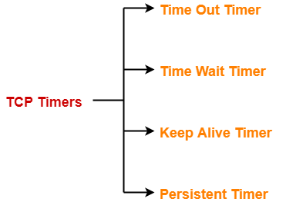
TCP timer management

Slide 12
Time Out Timer
TCP uses a time out timer for retransmission of lost segments
Sender starts a time out timer after transmitting a TCP segment to the receiver.
If sender receives an acknowledgement before the timer goes off, it stops the timer.
If sender does not receives any acknowledgement and the timer goes off, then TCP Retransmission occurs.
Sender retransmits the same segment and resets the timer.
The value of time out timer is dynamic and changes with the amount of traffic in the network.
Time out timer is also called as Retransmission Timer.

Slide 13
Time Wait Timer
TCP uses a time wait timer during connection termination
Sender starts the time wait timer after sending the ACK for the second FIN segment.
It allows to resend the final acknowledgement if it gets lost.
It prevents the just closed port from reopening again quickly to some other application.
It ensures that all the segments heading towards the just closed port are discarded.
The value of time wait timer is usually set to twice the lifetime of a TCP segment.

Slide 14
Keep Alive Timer
TCP uses a keep alive timer to prevent long idle TCP connections.
Each time server hears from the client, it resets the keep alive timer to 2 hours.
If server does not hear from the client for 2 hours, it sends 10 probe segments to the client.
These probe segments are sent at a gap of 75 seconds.
If server receives no response after sending 10 probe segments, it assumes that the client is down.
Then, server terminates the connection automatically.

Slide 15
Persistent Timer
TCP uses a persistent timer to deal with a zero-window-size deadlock situation.
It keeps the window size information flowing even if the other end closes its receiver window.
Explanation
Consider the following situation-
Sender receives an acknowledgment from the receiver with zero window size.
This indicates the sender to wait.
Later, receiver updates the window size and and sends the segment with the update to the sender.
This segment gets lost.
Now, both sender and receiver keeps waiting for each other to do something.
To deal with such a situation, TCP uses a persistent timer.

Slide 16
Sender starts the persistent timer on receiving an ACK from the receiver with a zero window size.
When persistent timer goes off, sender sends a special segment to the receiver.
This special segment is called as probe segment and contains only 1 byte of new data.
Response sent by the receiver to the probe segment gives the updated window size.
If the updated window size is non-zero, it means data can be sent now.
If the updated window size is still zero, the persistent timer is set again and the cycle repeats.

Slide 17
Thank You!
For any query/suggestions pls mail us at
suggestions@medicaps.ac.in

